Slide 1

DEPARTMENT OF ELECTRONICS AND COMMUNICATION ENGINEERING
FOOD DETECTOR USING ARDUINO
PROJECT GUIDE : BATCH NO : PRESENTED BY :
MR. SRINIVAS RAO D10 P. SURESH 18471A04K2
R. KARTHIKEYA 18471A04K6
CH. SAI TEJA 18471A04I4
A.PRASAD RAO 18471A04I1
A. VENU GOPAL 19475A0416

Slide 2
Outline :
Aim
Introduction
Existing Method
Proposed Method
Tools Required
Working
Circuit diagram
Advantages
Disadvantages
Applications
References
Future Scope
Output

Slide 3
Aim :
To detect the food item and to find of Nutritional quantity using Arduino.

Slide 4
Introduction
Need of Food detector is just for the curiosity to know different types of food items like Vegetables, Fruits by taking their internal resistance as the reference. Using this food detector, we can also find out the nutritional values of the food through this device as the decrease in the resistance values indicates the loss of the nutrients in the food.
Taking an unhealthy food will lead to different kinds of disease. Food security exists when all people at all times have physical, social and economic access to sufficient, safe and nutrition food, which meets dietary, needs for an active and healthy life

Slide 5
Existing Method
Chaitali Chandankhede [1] described to combat corruption in public distribution system (PDS). The system administrator can have a check on the availability of ratio to beneficiary on one side and the other side the customer can find out the nutrients quantity that are given by the government in Public Distribution Shops (PDS).
In the existing methodology, the texture analysis gives weather the given food is in good quality or not. Some health issues will occur due to the low nutritional food. The shopkeeper does not cheat customers by selling low quality or decayed food items. Customer monitor the product at the time of purchase. In this existing method, only the texture and PDS transparency and the achiever reliable accountability in the transaction of goods alone done. This work will detect the food nonrationality.

Slide 6
Proposed Method
Food safety is an important public health problem that relates to human health and economic development. Contaminated food material brings a lot of easy money to the traders, but it may spoil many lives. Low nutritional food can lead to slow poisoning and various kinds of diseases, which can even result in death. To overcome these types of drawbacks we have designed this proposed system for checking type of food nutritional quantity. In our method, the main module is resistance of the food item to detect and to display the nutritional values. The output of the Arduino UNO is through the LCD screen, which displays the type of food detected and the nutritional values of the food.

Slide 7
Tools Required
Arduino UNO
LCD screen
Potentiometer
Jumper wires
Connecting probes
Bread Board

Slide 8
Working
A simple cheap and effective food detector and nutritional quantity retrieving has been developed in this project.
Different foods have different resistances, you can use food detector to detect your unknown food and unknown nutritional values by just putting it into IF and ELSE loop
The circuit is based on detecting internal resistance of the given fruit or vegetables, we initially check the resistance of the different kinds of food item and code it in to the Arduino. When the probes are connected to the fruit or vegetable, it take the internal resistance of that fruit or vegetable and finally executes in the loop. So, if the gathered resistance is equal to the internal resistance then the particular fruit or vegetable with nutritional quantity, will be displayed on the LCD screen.

Slide 9
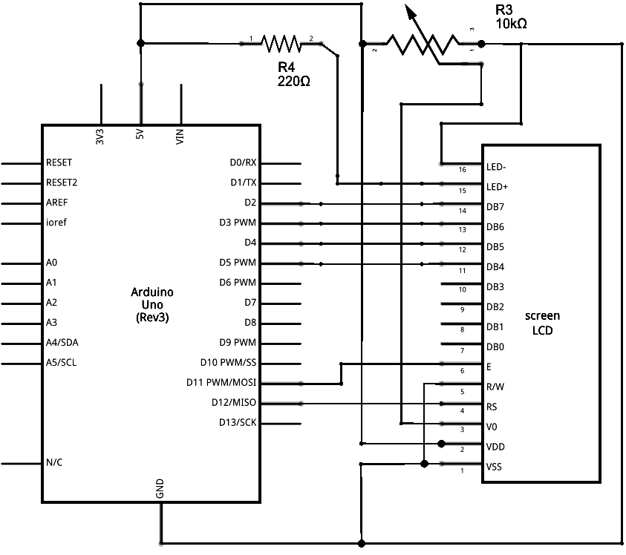
CIRCUIT CONNECTION

Slide 10
Advantages
This helps in identifying the various types food that we tend to eat.
It can be used as a futuristic learning process of the different types of eatables.
Complexity in designing this is very low.

Slide 11
Disadvantages
System not able to read exact value of resistance using jumper wires.
We were trying to get resistance values for cut open apple, but they kept changing abnormally from time to time.

Slide 12

Applications
Restaurants
Home
Hotels

Slide 13
References
Web-site
www.arduino.cc
www.wikipedia.org
www.hackster.io

Slide 14
Future scope
This application is used by farmers to detect how much time their food stay fresh.
With the use of this application users can also determine the taste of food.
user can also get output in the form of voice by attaching speaker with circuit.
User can also detect inhabitant food.
It can further be developed to determine the nutritional values of the food.

Slide 15
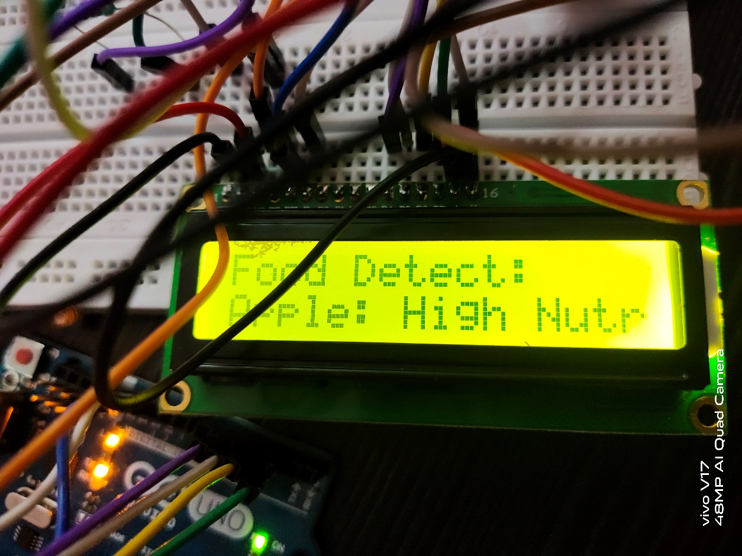
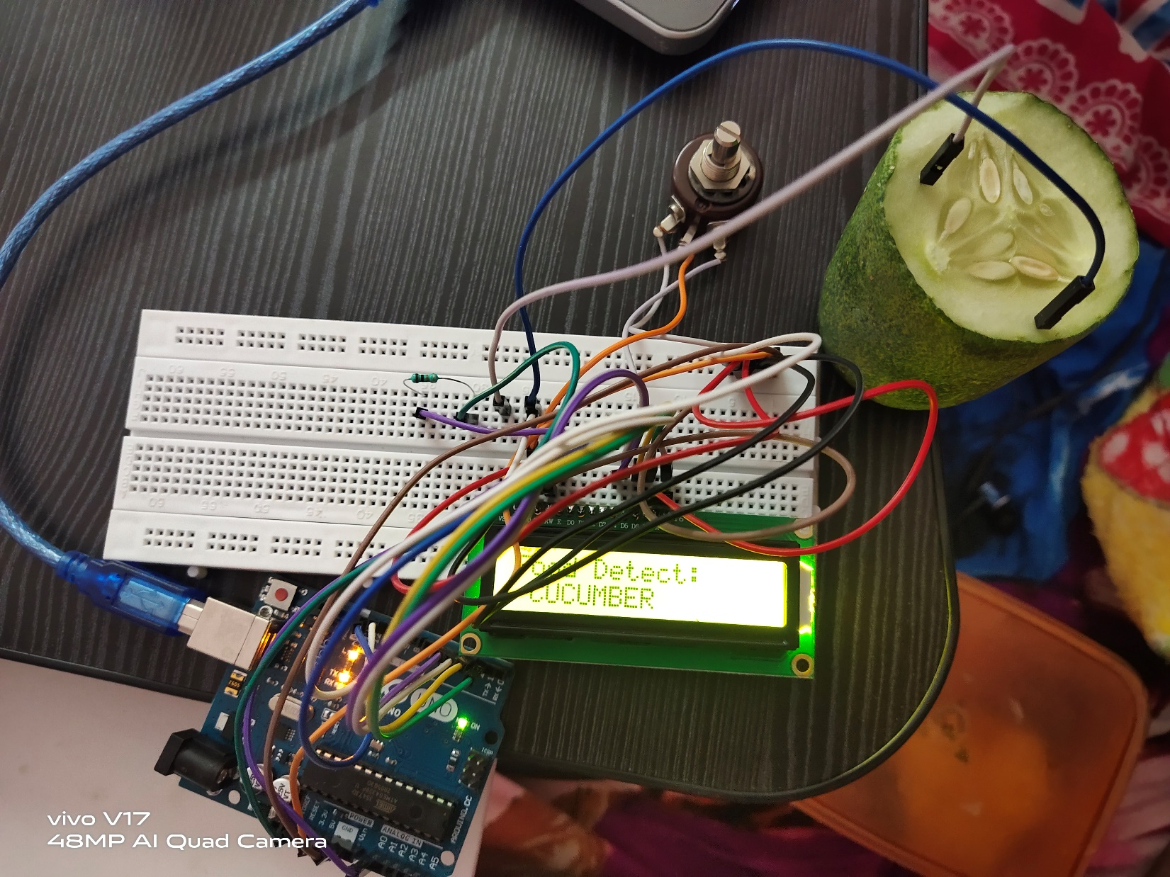
Output

Slide 16


